Slide 1
1 Data and Data Preparation
Business Statistics:
Communicating with Numbers, 4e
By Sanjiv Jaggia and Alison Kelly

Slide 2
Chapter 1 Learning Objectives (LOs)
LO 1.1 Explain the various data types.
LO 1.2 Describe variables and types of measurement scales.
LO 1.3 Inspect and explore data.
LO 1.4 Apply data subsetting.

Slide 3
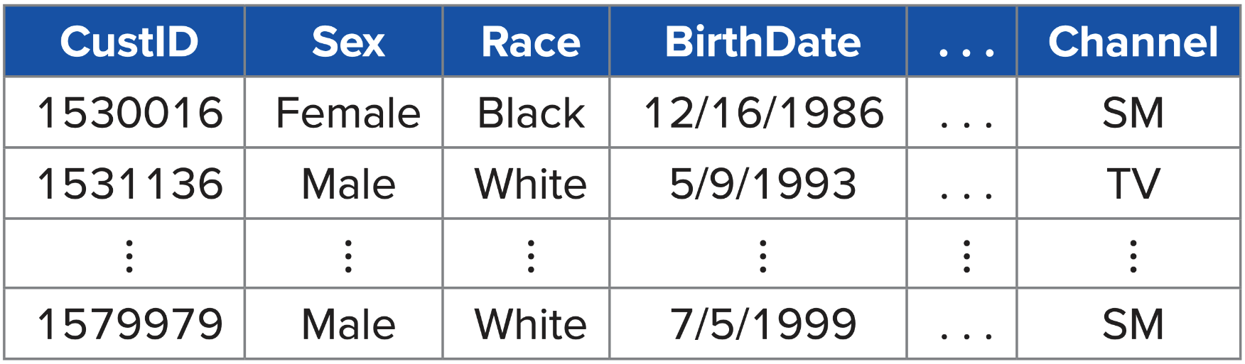
Introductory Case: Retail Customer Data (1)
Design a marketing campaign for Organic Food Superstore.
Use the data set to:
Identify Organic Food Superstore’s college-educated millennial customers.
Compare the profiles of female and male college-educated millennial customers.

Slide 4
1.1: Types of Data (1)
Data are compilations of facts, figures, or other contents, both numerical and non-numerical.
All types/formats are generated from multiple sources.
Customers/businesses use data from to help make decisions.
Statistics is the language of data.
Statistics is the science that deals with the collection, preparation, analysis, interpretation, and presentation of data.
First: find the right data and prepare it for the analysis.
Second: use the appropriate statistical tool, which depends on the data.
Third: clearly communicate information with actionable business insights.

Slide 5
1.1: Types of Data (2)
There are two branches of statistics: descriptive and inferential statistics.
Descriptive statistics refers to the summary of important aspects of a data set.
Includes collecting, organizing, and presenting the data in the form of charts and tables.
Often calculate numerical measures (typical value, variability).
Inferential statistics refers to drawing conclusions about a larger set of data (population) based on a smaller set of data (sample).
A population consists of all items/members of interest.
A sample is a subset of the population.
We rely on sample data to make inferences about various characteristics of the population.

Slide 6
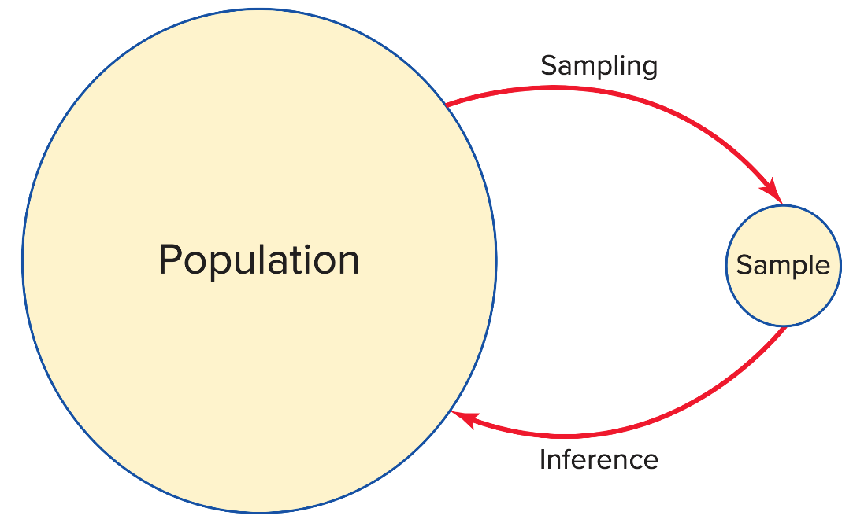
1.1: Types of Data (3)
We analyze sample data and calculate a sample statistic to make inferences about the unknown population parameter.
It is generally not feasible to obtain population data.
Obtaining information on the entire population is expensive.
It is impossible to examine every member of the population.
Sample data are generally collected in one of two ways.

Slide 7
1.1: Types of Data (4)
Cross-sectional data refers to data collected by recording a characteristic of many subjects at the same point in time, or without regard to differences in time.
Example: 2018-2019 NBA Eastern Conference standings

Slide 8
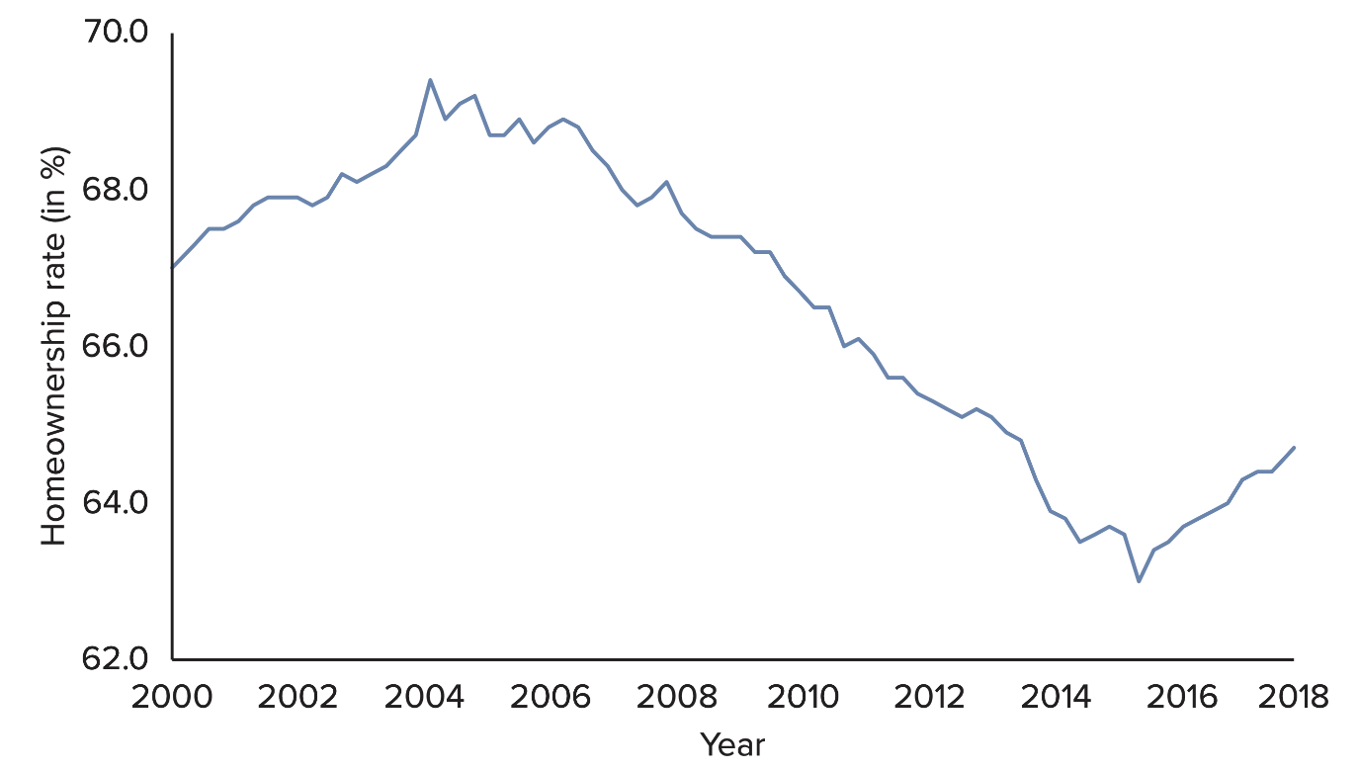
1.1: Types of Data (5)
Time series data refers to data collected over several time periods focusing on certain groups of people, specific events, or objects.
Time series data can include hourly, daily, weekly, monthly, quarterly, or annual observations.
Example: homeownership rates (%) in the US.

Slide 9
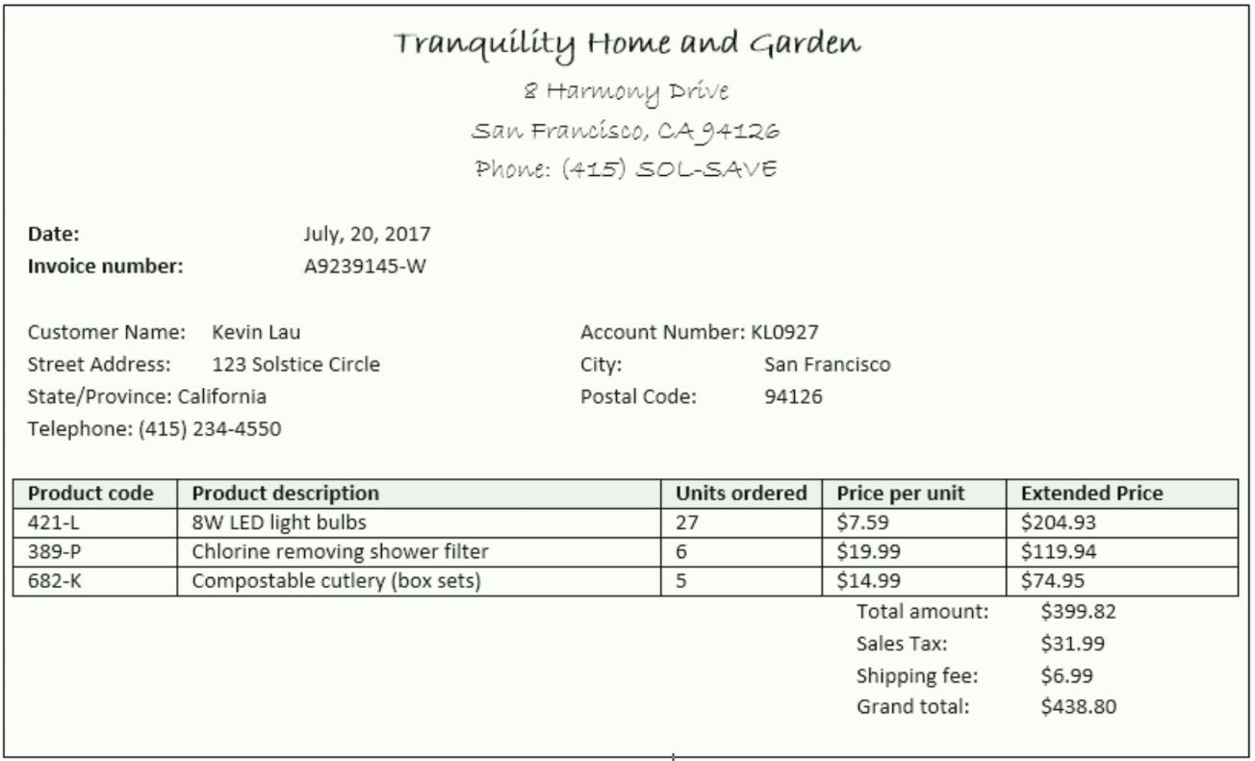
1.1: Types of Data (6)
Structured data
Reside in a pre-defined, row-column format.
Spreadsheet or database applications.
Enter, store, query, and analyze.
Numerical information that is objective and not open to interpretation.

Slide 10
1.1: Types of Data (7)
Today, only about 20% of all data used in business decisions are structured.
Unstructured data
Do not conform to a pre-defined, row-column format.
Textual and multimedia content.
Do not conform to database structures.
These data may have some implied structure.
Still considered unstructured.
Do not conform to a row-column model required in most database systems.
Example: social media data such as Twitter, YouTube, Facebook, and blogs.

Slide 11
1.1: Types of Data (8)
Businesses generate and gather more and more data at an increasing pace: Big Data.
A massive volume of structured and unstructured data
Extremely difficult to manage, process, and analyze using traditional data processing tools
Presents great opportunities to gain knowledge and game-changing intelligence
“[H]igh-volume, high-velocity and/or high-variety information assets that demand cost-effective, innovative forms of information processing that enable enhanced insight, decision making, and process automation” (www.gartner.com).
Does not imply complete (population) data
Big data may not be used when available
Inconvenient and computationally burdensome
Benefits may not justify costs

Slide 12
1.1: Types of Data (9)
There are three characteristics of big data.
Volume: immense amount of data complied for a single or multiple sources
Velocity: generated at a rapid speed, management is a critical issue
Variety: all types, forms, granularity, structured or unstructured
Additional characteristics
Veracity: credibility and quality of the data, reliability
Values: methodological plan for formulating questions, curating the right data and unlocking hidden potential
Having a plethora of data does not guarantee that useful insights or measurable improvements will be generated.

Slide 13
1.1: Types of Data (10)
There is an abundance of data on the Internet.
Many experts believe that 90% of the data in the world today was created in the last two years alone.
It is easy to access and find data by using a search engine like Google.
There are several sources of data.
Bureau of Economic Analysis
Bureau of Labor Statistics
Federal Research Economic Data
U.S. Census Bureau
National Climate Data Center
Yahoo Finance, Google Finance
Zillow
ESPN

Slide 14
1.2: Variables and Scales of Measurement (1)
A variable is a characteristic of interest that differs in kind or degree among various observations (records).
There are two types of variables: categorical and numeric.
Categorical Data
Also called qualitative
Represent categories
Labels or names to identify distinguishing characteristics
Can be defined by two or more categories
Coded into numbers for data processing
Example: marital status, grade in a course

Slide 15
1.2: Variables and Scales of Measurement (2)
For a numerical variable, we use numbers to identify the distinguishing characteristic of each observation.
Numeric Data
Also called quantitative
Represent meaningful numbers
Either discrete or continuous
A discrete variable assumes a countable number of values.
The values need not be whole numbers
Example: number of children in a family
A continuous variable assumes an uncountable number of values within an interval.
In practice, often measure in discrete values
Example: weight of a newborn baby
In order to choose the appropriate techniques for summarizing and analyzing variables, we need to distinguish between the different measurement scales.

Slide 16
1.2: Variables and Scales of Measurement (3)
There are four major scales: nominal, ordinal, interval, ratio.
Nominal and ordinal scales are used for categorical variables.
Nominal
Least sophisticated
Represent categories or groups
Values differ by label or name
Example: marital status
Ordinal
Stronger level of measurement
Categorize and rank data with respect to some characteristic
Cannot interpret the difference between the ranked values, numbers are arbitrary
Example: reviews from 1 star (poor) to 5 starts (outstanding)
Categorical variable are typically expressed in words but are coded into numbers for purposes of data processing.
Typically count the number of observations that fall into each category (or find percentages)
Unable to perform meaningful arithmetic operations

Slide 17
1.2: Variables and Scales of Measurement (4)
Interval and ratio scales are used for numerical variables.
Interval
Categorize and rank, differences are meaningful
Zero value is arbitrary and does not reflect absence of characteristic
Ratios are not meaningful
Example: temperature
Ratio
Strongest level of measurement
A true zero point, reflects absence of characteristic
Ratios are meaningful
Example: profits
Arithmetic operations are valid on interval- and ratio-scaled variable.

Slide 18
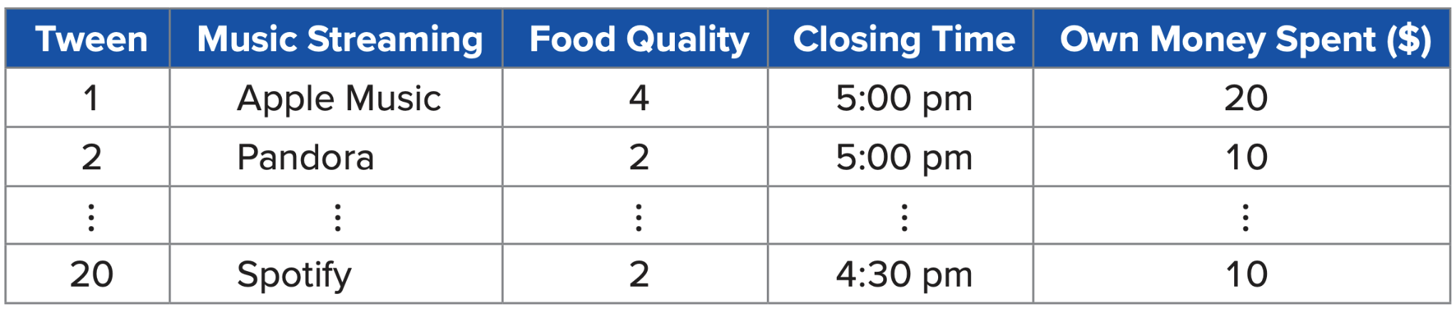
1.2: Variables and Scales of Measurement (5)
Example: The owner of a ski resort gathers data on tweens.
Music: nominal
Food quality: ordinal
Closing time: interval
Own money spent: ratio

Slide 19
1.3: Data Preparation (1)
We often spend a considerable amount of time inspecting and preparing the data for the subsequent analysis.
Counting and sorting
Handling missing values
Subsetting
Counting and Sorting
Among the very first tasks analysts perform
Gain a better understanding and insights into the data
Help to verify that the data set is complete or determine if there are missing values
Sorting allows us to review the range of values for each variable
Sort based on a single or multiple variables

Slide 20
1.3: Data Preparation (2)
There are two common strategies for dealing with missing values.
The omission strategy recommends that observations with missing values be excluded from subsequent analysis.
The imputation strategy recommends that the missing values be replaced with some reasonable imputed values.
Numeric variables: replace with the average
Categorical variables: replace with the predominant category

Slide 21
1.3: Data Preparation (3)
Subsetting is the process of extracting a portion of the data set that is relevant for subsequent statistical analysis.
The objective of the analysis is to compare two subsets of the data.
Eliminate observations that contain missing values, low-quality data, or outliers.
Excluding variables that contain redundant information, or variables with excessive amounts of missing values.
We can also subset data based on data ranges.

